Slide 1
rdt2.0: channel with bit errors
underlying channel may flip bits in packet
checksum to detect bit errors
the question: how to recover from errors?
acknowledgements (ACKs): receiver explicitly tells sender that pkt received OK
negative acknowledgements (NAKs): receiver explicitly tells sender that pkt had errors
sender retransmits pkt on receipt of NAK
stop and wait
sender sends one packet, then waits for receiver response

Slide 2
rdt2.0: FSM specifications
rdt_send(data)
snkpkt = make_pkt(data, checksum)
udt_send(sndpkt)
rdt_rcv(rcvpkt) &&
isNAK(rcvpkt)
sender
Wait for call from above
Wait for ACK or NAK
udt_send(sndpkt)
rdt_rcv(rcvpkt) && corrupt(rcvpkt)
udt_send(NAK)
rdt_rcv(rcvpkt) && isACK(rcvpkt)
Wait for call from below
Λ
receiver
rdt_rcv(rcvpkt) && notcorrupt(rcvpkt)
extract(rcvpkt,data)
deliver_data(data)
udt_send(ACK)

Slide 3

rdt2.0: FSM specification
rdt_send(data)
snkpkt = make_pkt(data, checksum)
udt_send(sndpkt)
rdt_rcv(rcvpkt) &&
isNAK(rcvpkt)
sender
Wait for call from above
Wait for ACK or NAK
isNAK(rcvpkt)
udt_send(sndpkt)
rdt_rcv(rcvpkt) && corrupt(rcvpkt)
udt_send(NAK)
rdt_rcv(rcvpkt) && isACK(rcvpkt)
isACK(rcvpkt)
Wait for call from below
Λ
receiver
Note: “state” of receiver (did the receiver get my message correctly?) isn’t known to sender unless somehow communicated from receiver to sender
that’s why we need a protocol!
rdt_rcv(rcvpkt) && notcorrupt(rcvpkt)
extract(rcvpkt,data)
deliver_data(data)
udt_send(ACK)

Slide 4
rdt2.0: operation with no errors
rdt_send(data)
snkpkt = make_pkt(data, checksum)
udt_send(sndpkt)
rdt_rcv(rcvpkt) &&
isNAK(rcvpkt)
sender
Wait for call from above
Wait for ACK or NAK
udt_send(sndpkt)
rdt_rcv(rcvpkt) && corrupt(rcvpkt)
udt_send(NAK)
rdt_rcv(rcvpkt) && isACK(rcvpkt)
Wait for call from below
Λ
receiver
rdt_rcv(rcvpkt) && notcorrupt(rcvpkt)
extract(rcvpkt,data)
deliver_data(data)
udt_send(ACK)

Slide 5
rdt2.0: corrupted packet scenario
rdt_send(data)
snkpkt = make_pkt(data, checksum)
udt_send(sndpkt)
rdt_rcv(rcvpkt) &&
isNAK(rcvpkt)
sender
Wait for call from above
Wait for ACK or NAK
udt_send(sndpkt)
rdt_rcv(rcvpkt) && corrupt(rcvpkt)
udt_send(NAK)
rdt_rcv(rcvpkt) && isACK(rcvpkt)
Wait for call from below
Λ
receiver
rdt_rcv(rcvpkt) && notcorrupt(rcvpkt)
extract(rcvpkt,data)
deliver_data(data)
udt_send(ACK)

Slide 6
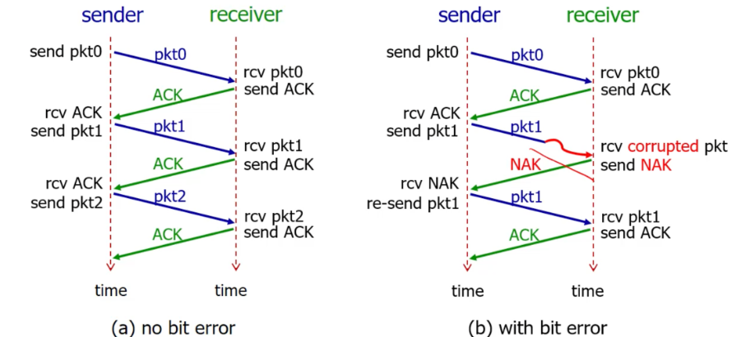
rdt2.0 in action

Slide 7
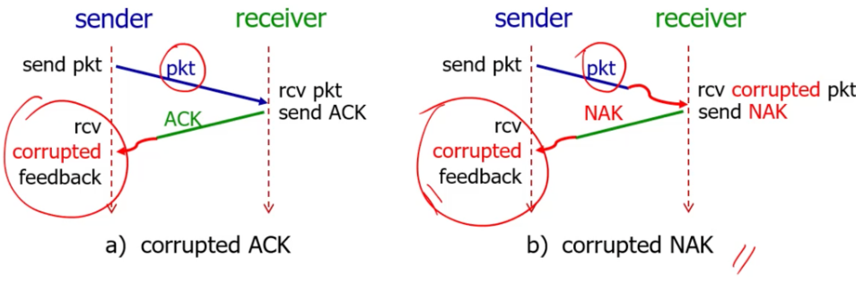
rdt2.0 has a fatal flaw!
what happens if ACK/NAK corrupted?
sender doesn’t know what happened at receiver!
can’t just retransmit: possible duplicate
For corrupted NAK, sending the packet again will be just fine,
However for corrupted ACK, sending the packet again will create a duplicate of the already received packet.
Duplicate happens because of corrupted ACK!!
handling duplicates:
sender retransmits current pkt if ACK/NAK corrupted
sender adds sequence number to each pkt
receiver discards (doesn’t deliver up) duplicate pkt
stop and wait
sender sends one packet, then waits for receiver response

Slide 8
rdt2.1: sender, handling garbled ACK/NAKs
rdt_send(data)
sndpkt = make_pkt(0, data, checksum)
udt_send(sndpkt)
rdt_rcv(rcvpkt) && (corrupt(rcvpkt) ||
isNAK(rcvpkt) )
Wait for call 0 from above
Wait for ACK or NAK 0
udt_send(sndpkt)
rdt_rcv(rcvpkt)
&& notcorrupt(rcvpkt) && isACK(rcvpkt)
rdt_rcv(rcvpkt)
&& notcorrupt(rcvpkt)
&& isACK(rcvpkt)
Λ
Λ
Wait for ACK or NAK 1
Wait for
call 1 from above
rdt_rcv(rcvpkt)
&& (corrupt(rcvpkt) ||
isNAK(rcvpkt) )
rdt_send(data)
udt_send(sndpkt)
sndpkt = make_pkt(1, data, checksum)
udt_send(sndpkt)

Slide 9
rdt2.1: receiver, handling garbled ACK/NAKs
rdt_rcv(rcvpkt) && notcorrupt(rcvpkt)
&& has_seq0(rcvpkt)
extract(rcvpkt,data)
deliver_data(data)
sndpkt = make_pkt(ACK, chksum)
udt_send(sndpkt)
rdt_rcv(rcvpkt) && (corrupt(rcvpkt)
rdt_rcv(rcvpkt) && (corrupt(rcvpkt)
sndpkt = make_pkt(NAK, chksum)
udt_send(sndpkt)
sndpkt = make_pkt(NAK, chksum)
udt_send(sndpkt)
Wait for
0 from below
Wait for
1 from below
rdt_rcv(rcvpkt) &&
not corrupt(rcvpkt) &&
has_seq1(rcvpkt)
rdt_rcv(rcvpkt) &&
not corrupt(rcvpkt) &&
has_seq0(rcvpkt)
sndpkt = make_pkt(ACK, chksum)
udt_send(sndpkt)
sndpkt = make_pkt(ACK, chksum)
udt_send(sndpkt)
rdt_rcv(rcvpkt) && notcorrupt(rcvpkt)
&& has_seq1(rcvpkt)
extract(rcvpkt,data)
deliver_data(data)
sndpkt = make_pkt(ACK, chksum)
udt_send(sndpkt)

Slide 10
rdt2.1: discussion
sender:
seq # added to pkt
two seq. #s (0,1) will suffice. Why?
must check if received ACK/NAK corrupted
twice as many states
state must “remember” whether “expected” pkt should have seq # of 0 or 1
receiver:
must check if received packet is duplicate
state indicates whether 0 or 1 is expected pkt seq #
note: receiver can not know if its last ACK/NAK received OK at sender

Slide 11
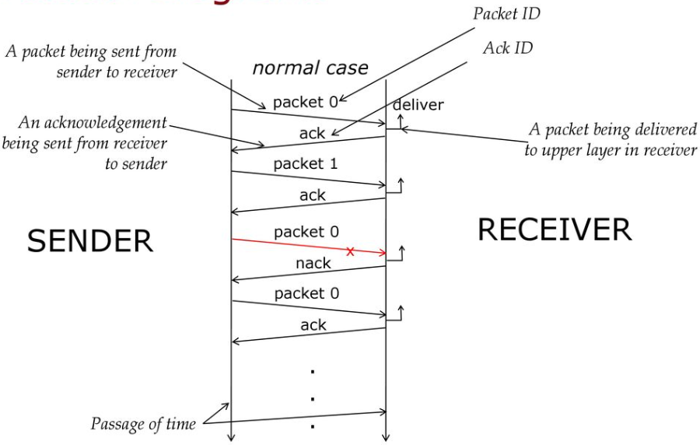
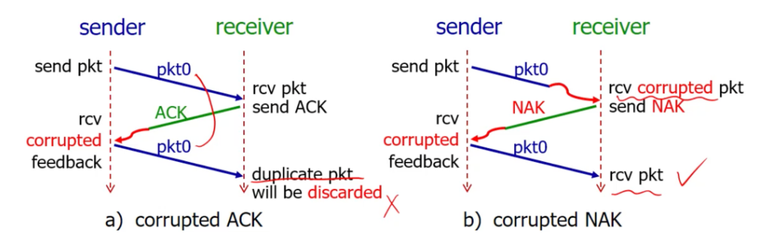
rdt2.1 in action

Slide 12
rdt2.2: a NAK-free protocol
same functionality as rdt2.1, using ACKs only
instead of NAK, receiver sends ACK for last pkt received OK
receiver must explicitly include seq # of pkt being ACKed
duplicate ACK at sender results in same action as NAK: retransmit current pkt
As we will see, TCP uses this approach to be NAK-free

Slide 13
rdt2.2: sender, receiver fragments
rdt_send(data)
sndpkt = make_pkt(0, data, checksum)
udt_send(sndpkt)
rdt_rcv(rcvpkt) &&
( corrupt(rcvpkt) ||
isACK(rcvpkt,1) )
Wait for call 0 from above
Wait for ACK
0
udt_send(sndpkt)
sender FSM
fragment
rdt_rcv(rcvpkt)
&& notcorrupt(rcvpkt)
&& isACK(rcvpkt,0)
rdt_rcv(rcvpkt) &&
(corrupt(rcvpkt) ||
has_seq1(rcvpkt))
Λ
Wait for
0 from below
receiver FSM
fragment
udt_send(sndpkt)
rdt_rcv(rcvpkt) && notcorrupt(rcvpkt)
&& has_seq1(rcvpkt)
extract(rcvpkt,data)
deliver_data(data)
sndpkt = make_pkt(ACK1, chksum)
udt_send(sndpkt)

Slide 14
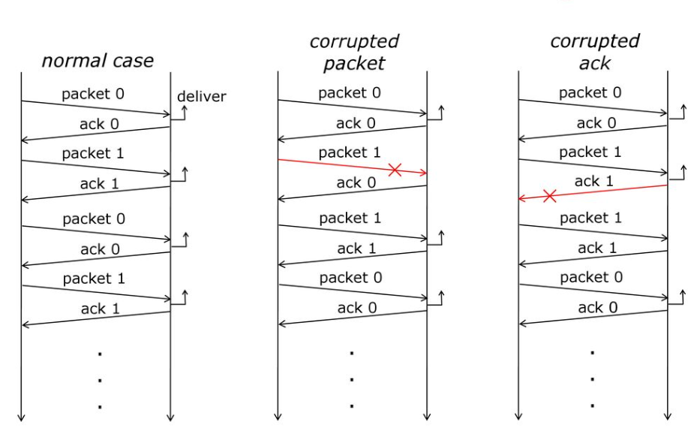
rdt2.2 in action

Slide 15
rdt3.0: channels with errors and loss
New channel assumption: underlying channel can also lose packets (data, ACKs)
checksum, sequence #s, ACKs, retransmissions will be of help … but not quite enough
Q: How do humans handle lost sender-to-receiver words in conversation?

Slide 16

rdt3.0: channels with errors and loss
Approach: sender waits “reasonable” amount of time for ACK
retransmits if no ACK received in this time
if pkt (or ACK) just delayed (not lost):
retransmission will be duplicate, but seq #s already handles this!
receiver must specify seq # of packet being ACKed
use countdown timer to interrupt after “reasonable” amount of time
timeout

Slide 17
rdt3.0 sender
rdt_send(data)
sndpkt = make_pkt(0, data, checksum)
udt_send(sndpkt)
start_timer
Wait for
call 0 from above
Wait for ACK0
rdt_rcv(rcvpkt)
&& notcorrupt(rcvpkt)
&& isACK(rcvpkt,1)
rdt_rcv(rcvpkt)
&& notcorrupt(rcvpkt)
&& isACK(rcvpkt,0)
stop_timer
stop_timer
Wait for ACK1
Wait for
call 1 from above
rdt_send(data)
sndpkt = make_pkt(1, data, checksum)
udt_send(sndpkt)
start_timer
Notes:
We see the familiar four state sender from our rdt 2.1 and 2.2 protocols. Top two states when sending packet with zero seq # and bottom two

Slide 18
rdt3.0 sender
rdt_send(data)
rdt_rcv(rcvpkt) &&
( corrupt(rcvpkt) ||
isACK(rcvpkt,1) )
sndpkt = make_pkt(0, data, checksum)
udt_send(sndpkt)
start_timer
rdt_rcv(rcvpkt)
Λ
Λ
Wait for
call 0 from above
Wait for ACK0
timeout
udt_send(sndpkt)
start_timer
rdt_rcv(rcvpkt)
&& notcorrupt(rcvpkt)
&& isACK(rcvpkt,1)
rdt_rcv(rcvpkt)
&& notcorrupt(rcvpkt)
&& isACK(rcvpkt,0)
stop_timer
stop_timer
Wait for ACK1
Wait for
call 1 from above
timeout
udt_send(sndpkt)
start_timer
rdt_rcv(rcvpkt)
rdt_send(data)
Λ
rdt_rcv(rcvpkt) &&
( corrupt(rcvpkt) ||
isACK(rcvpkt,0) )
sndpkt = make_pkt(1, data, checksum)
udt_send(sndpkt)
start_timer
Λ
Notes:
We see the familiar four state sender from our rdt 2.1 and 2.2 protocols. Top two states when sending packet with zero seq # and bottom two

Slide 19

rdt3.0 in action
sender
receiver
sender
receiver
send pkt0
pkt0
send pkt0
pkt0
rcv pkt0
rcv pkt0
ack0
send ack0
ack0
send ack0
rcv ack0
rcv ack0
send pkt1
pkt1
send pkt1
pkt1
rcv pkt1
X
ack1
send ack1
loss
rcv ack1
send pkt0
pkt0
rcv pkt0
timeout
resend pkt1
ack0
send ack0
pkt1
rcv pkt1
ack1
send ack1
rcv ack1
send pkt0
pkt0
(a) no loss
rcv pkt0
ack0
send ack0
(b) packet loss

Slide 20
rdt3.0 in action
sender
receiver
sender
receiver
send pkt0
pkt0
rcv pkt0
send pkt0
pkt0
send ack0
rcv pkt0
rcv ack0
ack0
ack0
send ack0
send pkt1
pkt1
rcv ack0
rcv pkt1
send pkt1
pkt1
send ack1
rcv pkt1
ack1
ack1
send ack1
X
timeout
resend pkt1
loss
pkt1
rcv pkt1
timeout
resend pkt1
rcv ack1
(detect duplicate)
pkt1
rcv pkt1
send ack1
send pkt0
pkt0
ack1
(detect duplicate)
rcv pkt0
rcv ack1
send ack1
rcv ack1
ack1
ack0
send ack0
send pkt0
pkt0
(ignore)
rcv pkt0
ack0
send ack0
pkt1
(c) ACK loss
(d) premature timeout/ delayed ACK

Slide 21
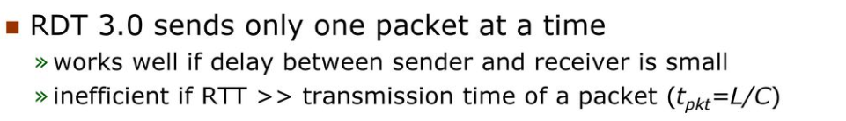
Performance of rdt3.0 (stop-and-wait)
U _{sender}: utilization – fraction of time sender busy sending
example: 1 Gbps link, 15 ms prop. delay, 8000 bit packet
time to transmit packet into channel:
L
8000 bits
D_{trans} =
=
=
8 microsecs
R
10⁹ bits/sec
Notes:
if RTT=30 msec, 1KB pkt every 30 msec: 33kB/sec thruput over 1 Gbps link
network protocol limits use of physical resources
Let’s develop a formula for utilization

Slide 22
rdt3.0: stop-and-wait operation
sender
receiver
first packet bit transmitted, t = 0
first packet bit arrives
RTT
last packet bit arrives, send ACK
ACK arrives, send next
packet, t = RTT + L / R

Slide 23
rdt3.0: stop-and-wait operation
sender
receiver
L / R
=
L/R
U_{sender}
RTT
+ L / R
.008
RTT
=
This scenario demonstrates the inefficiency of RDT 3.0, a non-pipelined protocol, particularly when the propagation delay is significant in comparison to the packet transmission time
30.008
=
0.00027
rdt 3.0 protocol performance stinks!
Protocol limits performance of underlying infrastructure (channel)
The performance is limited because the sender spends most of the time waiting rather than transmitting.

Slide 24
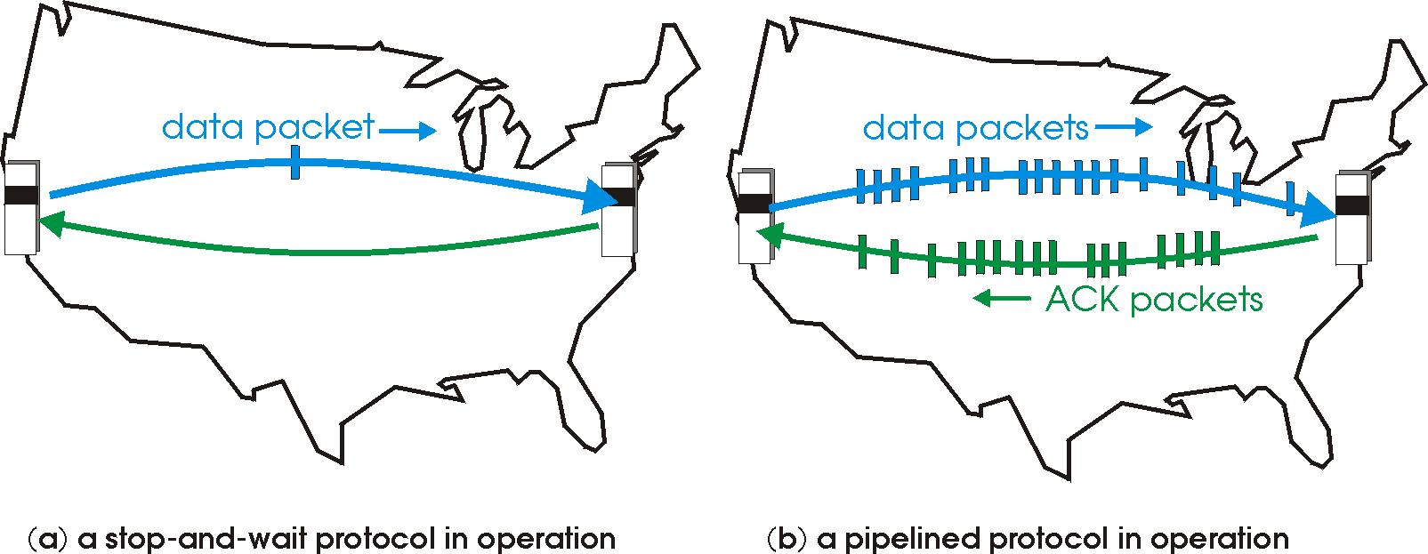

rdt3.0: pipelined protocols operation
pipelining: sender allows multiple, “in-flight”, yet-to-be-acknowledged packets
range of sequence numbers must be increased
buffering at sender and/or receiver

Slide 25
Pipelining: increased utilization
sender
receiver
first packet bit transmitted, t = 0
last bit transmitted, t = L / R
first packet bit arrives
RTT
last packet bit arrives, send ACK
last bit of 2nd packet arrives, send ACK
last bit of 3rd packet arrives, send ACK
ACK arrives, send next
packet, t = RTT + L / R
3-packet pipelining increases
utilization by a factor of 3!
By using pipelining, the protocol's efficiency is improved, thereby taking better advantage of the underlying infrastructure's capacity.
Notes:
two generic forms of pipelined protocols: go-Back-N, selective repeat

Slide 26
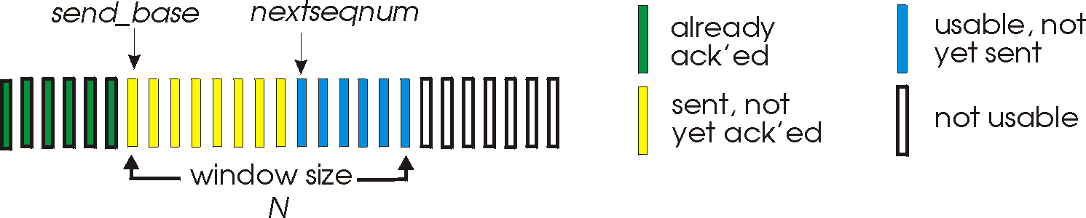
Go-Back-N: sender
sender: “window” of up to N, consecutive transmitted but unACKed pkts
k-bit seq # in pkt header
cumulative ACK: ACK(n): ACKs all packets up to, including seq # n
on receiving ACK(n): move window forward to begin at n+1
timer for oldest in-flight packet
timeout(n): retransmit packet n and all higher seq # packets in window
Notes:
window size of 14, 8 have been sent but are not yet acknowledged, 6 sequence numbers are available for us. In window, but no calls from above to use them.
Note – we’ll skip the Go-Back-N FSM specification you can check that out in PowerPoint slides or book)
TCP uses cumulative ACK

Slide 27
Go-Back-N: receiver
ACK-only: always send ACK for correctly-received packet so far, with highest in-order seq #
may generate duplicate ACKs
need only remember rcv_base
on receipt of out-of-order packet:
can discard (don’t buffer) or buffer: an implementation decision
re-ACK pkt with highest in-order seq #
Receiver view of sequence number space:
received and ACKed
…
…
Out-of-order: received but not ACKed
rcv_base
Not received
Notes:
Note – we’ll skip the Go-Back-N FSM specification (actually it’s

Slide 28
Go-Back-N in action
sender window (N=4)
sender
receiver
0 1 2 3 4 5 6 7 8
send pkt0
send pkt1
send pkt2
send pkt3
(wait)
0 1 2 3 4 5 6 7 8
receive pkt0, send ack0
receive pkt1, send ack1
receive pkt3, discard,
(re)send ack1
0 1 2 3 4 5 6 7 8
X
0 1 2 3 4 5 6 7 8
loss
0 1 2 3 4 5 6 7 8
rcv ack0, send pkt4
0 1 2 3 4 5 6 7 8
rcv ack1, send pkt5
receive pkt4, discard,
(re)send ack1
ignore duplicate ACK
receive pkt5, discard,
(re)send ack1
pkt 2 timeout
0 1 2 3 4 5 6 7 8
send pkt2
send pkt3
send pkt4
send pkt5
0 1 2 3 4 5 6 7 8
0 1 2 3 4 5 6 7 8
rcv pkt2, deliver, send ack2
rcv pkt3, deliver, send ack3
rcv pkt4, deliver, send ack4
rcv pkt5, deliver, send ack5
0 1 2 3 4 5 6 7 8
Notes:
Let’s skip FSM specification for GBN – check out the book or ppt – and let’s watch GBN sender and receivers in action.
Let assume a window size of 4. at t=0, sender sends packets 0, 1, 2 3, 4, and packet 2 will be lost
At the receiver:
Packet 0 received ACK0 generated
Packet 1 received ACK1 generated
Packet 2 is lost, and so when packet 3 is received, ACK 1 is sent – that’s the cumulative ACK, re-Acknowledging the receipt of packet 1. and in this implementation packet 3 is discarded

Slide 29
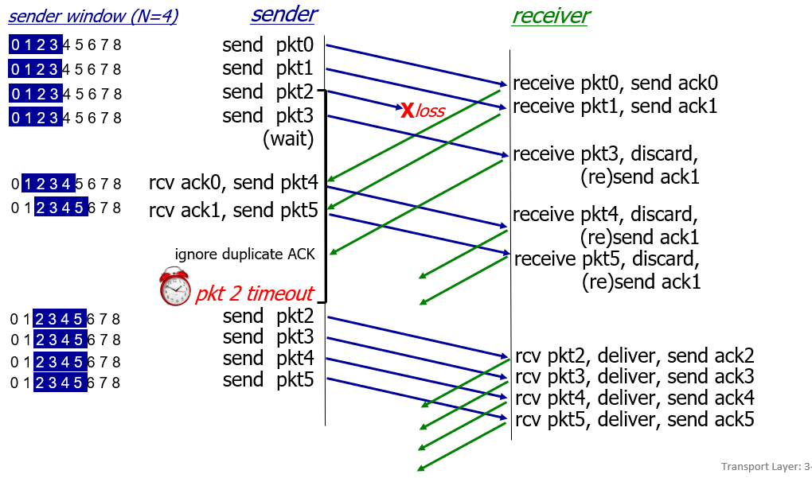
Go-Back-N in action - Explanation
Sender Side: The sender window is shown at different points in time, with the window size being N (N=4). Four unacknowledged packets in transit.
Packet Transmission: Packets are sent sequentially i-e pkt0, pkt1, etc.,
Loss of a Packet: At some point, a packet (pkt2) is lost in transmission
Receiver Side: Receives packets pkt0 and pkt1 and sends acknowledgments ack0 and ack1, respectively. When it receives pkt3, it discards it because it's out of order (since pkt2 was lost) and resends ack1.
Duplicate ACKs: The receiver continues to send ack1 for each subsequent packet it receives out of order.
Timeout: After a timeout for pkt2 occurs (indicating the sender has not received an acknowledgment for pkt2 within a certain time frame), the sender retransmits pkt2 and all subsequent packets.
Resumption of Transmission: After the timeout, the receiver finally gets pkt2 and the subsequent packets in order, delivering them to the upper layer and sending the corresponding acks (ack2, ack3, ack4, and ack5).
Progress of Sender's Window: Throughout the process, the sender's window progresses as packets are acknowledged, allowing for the transmission of new packets
The protocol is called "Go-Back-N," as the sender goes back to retransmit the Nth packet and all following packets in the window when an error is detected or a packet is lost.
Notes:
Let’s skip FSM specification for GBN – check out the book or ppt – and let’s watch GBN sender and receivers in action.
Let assume a window size of 4. at t=0, sender sends packets 0, 1, 2 3, 4, and packet 2 will be lost
At the receiver:
Packet 0 received ACK0 generated
Packet 1 received ACK1 generated
Packet 2 is lost, and so when packet 3 is received, ACK 1 is sent – that’s the cumulative ACK, re-Acknowledging the receipt of packet 1. and in this implementation packet 3 is discarded

Slide 30
Selective repeat: the approach
pipelining: multiple packets in flight
receiver individually ACKs all correctly received packets
buffers packets, as needed, for in-order delivery to upper layer
sender:
maintains (conceptually) a timer for each unACKed pkt
timeout: retransmits single unACKed packet associated with timeout
maintains (conceptually) “window” over N consecutive seq #s
limits pipelined, “in flight” packets to be within this window
Notes:
An important mechanism of GBN was the use of the cumulative acknowledgements, and as we mentioned, cumulative ACKs are used in TCP
An alternate ACK mechanism would be for the receiver to individually acknowledge specific packets as they are received. This mechanism is at the heart of the Selective repeat protocol.

Slide 31
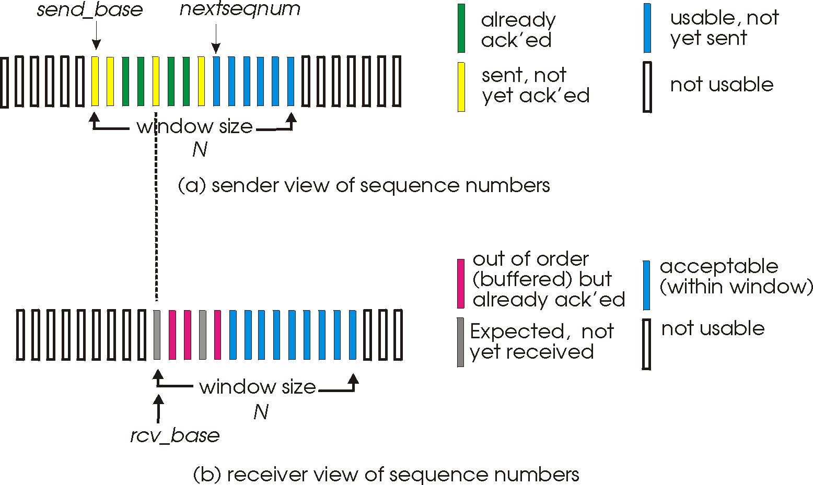
Selective repeat: sender, receiver windows

Slide 32
Selective repeat: sender and receiver
sender
receiver
data from above:
if next available seq # in window, send packet
timeout(n):
resend packet n, restart timer
ACK(n) in [sendbase,sendbase+N-1]:
mark packet n as received
if n smallest unACKed packet, advance window base to next unACKed seq #
packet n in [rcvbase, rcvbase+N-1]
send ACK(n)
out-of-order: buffer
in-order: deliver (also deliver buffered, in-order packets), advance window to next not-yet-received packet
packet n in [rcvbase-N,rcvbase-1]
ACK(n)
otherwise:
ignore
Notes:
If the packet is in order, its data will be delivered, as will any buffered data that can now be delivered in order

Slide 33
Selective Repeat in action
sender window (N=4)
sender
receiver
0 1 2 3 4 5 6 7 8
send pkt0
send pkt1
send pkt2
send pkt3
(wait)
0 1 2 3 4 5 6 7 8
receive pkt0, send ack0
receive pkt1, send ack1
receive pkt3, buffer,
send ack3
0 1 2 3 4 5 6 7 8
X
0 1 2 3 4 5 6 7 8
loss
0 1 2 3 4 5 6 7 8
rcv ack0, send pkt4
0 1 2 3 4 5 6 7 8
rcv ack1, send pkt5
receive pkt4, buffer,
send ack4
record ack3 arrived
receive pkt5, buffer,
send ack5
pkt 2 timeout
0 1 2 3 4 5 6 7 8
send pkt2
(but not 3,4,5)
0 1 2 3 4 5 6 7 8
0 1 2 3 4 5 6 7 8
rcv pkt2; deliver pkt2,
pkt3, pkt4, pkt5; send ack2
0 1 2 3 4 5 6 7 8
Q: what happens when ack2 arrives?

Slide 34
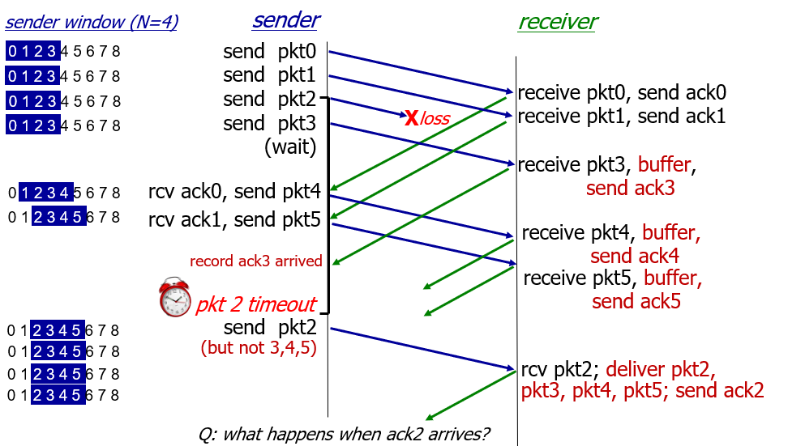
Selective Repeat in action - Explanation
The sender window size is depicted as N=4, and a series of packet transmissions are detailed:
Sender:
The sender transmits packets 0 to 3.
Packet 2 is lost in the transmission, and the sender waits after sending packet 3.
Upon receiving acknowledgments for packets 0 and 1 (ack0 and ack1), the sender proceeds to send packets 4 and 5.
After the timeout for packet 2 occurs, it is retransmitted by the sender.
Receiver:
The receiver, upon receiving packets 0, 1, and out-of-order packets 3, 4, and 5, sends the corresponding acknowledgments and buffers the out-of-order packets.
The receiver then receives packet 2, delivers the buffered packets 2, 3, 4, and 5 in the correct order, and sends acknowledgment 2 (ack2).
Q: what happens when ack2 arrives?"
A: When ack2 arrives, the sender should be able to move the window forward since it has now received acknowledgments for all packets up to packet 5.
.

Slide 35
Selective repeat: a dilemma!
sender window
(after receipt)
receiver window
(after receipt)
0 1 2 3 0 1 2
pkt0
0 1 2 3 0 1 2
pkt1
0 1 2 3 0 1 2
0 1 2 3 0 1 2
pkt2
0 1 2 3 0 1 2
example:
seq #s: 0, 1, 2, 3 (base 4 counting)
window size=3
0 1 2 3 0 1 2
0 1 2 3 0 1 2
pkt3
X
0 1 2 3 0 1 2
pkt0
will accept packet
with seq number 0
(a) no problem
0 1 2 3 0 1 2
pkt0
0 1 2 3 0 1 2
pkt1
0 1 2 3 0 1 2
0 1 2 3 0 1 2
pkt2
X
0 1 2 3 0 1 2
X
0 1 2 3 0 1 2
X
timeout
retransmit pkt0
0 1 2 3 0 1 2
pkt0
will accept packet
with seq number 0
(b) oops!

Slide 36

Selective repeat: a dilemma!
sender window
(after receipt)
receiver window
(after receipt)
0 1 2 3 0 1 2
pkt0
0 1 2 3 0 1 2
pkt1
0 1 2 3 0 1 2
0 1 2 3 0 1 2
pkt2
0 1 2 3 0 1 2
example:
seq #s: 0, 1, 2, 3 (base 4 counting)
window size=3
0 1 2 3 0 1 2
0 1 2 3 0 1 2
pkt3
X
0 1 2 3 0 1 2
receiver can’t see sender side
receiver behavior identical in both cases!
something’s (very) wrong!
pkt0
will accept packet
with seq number 0
(a) no problem
Q: what relationship is needed between sequence # size and window size to avoid problem in scenario (b)?
pkt0
0 1 2 3 0 1 2
0 1 2 3 0 1 2
pkt1
0 1 2 3 0 1 2
0 1 2 3 0 1 2
pkt2
X
0 1 2 3 0 1 2
X
0 1 2 3 0 1 2
X
timeout
retransmit pkt0
0 1 2 3 0 1 2
pkt0
will accept packet
with seq number 0
(b) oops!

Slide 37
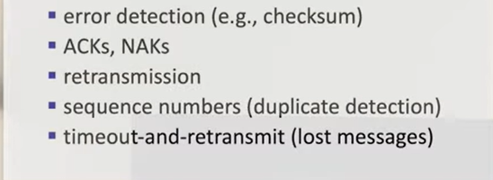
rdt protocol mechanism

Slide 38

Chapter 3: roadmap
Transport-layer services
Multiplexing and demultiplexing
Connectionless transport: UDP
Principles of reliable data transfer
Connection-oriented transport: TCP
segment structure
reliable data transfer
flow control
connection management
Principles of congestion control
TCP congestion control

Slide 39
TCP: overview RFCs: 793,1122, 2018, 5681, 7323
point-to-point:
one sender, one receiver
reliable, in-order byte steam:
no “message boundaries"
full duplex data:
bi-directional data flow in same connection
MSS: maximum segment size
cumulative ACKs
pipelining:
TCP congestion and flow control set window size
connection-oriented:
handshaking (exchange of control messages) initializes sender, receiver state before data exchange
flow controlled:
sender will not overwhelm receiver
Notes:
Typical MSS is 1460 bytes

Slide 40
TCP segment structure
32 bits
source port #
dest port #
segment seq #: counting bytes of data into bytestream (not segments!)
ACK: seq # of next expected byte; A bit: this is an ACK
sequence number
acknowledgement number
length (of TCP header)
head
len
not
used
A
P
S
receive window
flow control: # bytes receiver willing to accept
C
E
U
R
F
Internet checksum
checksum
Urg data pointer
options (variable length)
C, E: congestion notification
TCP options
application
data
(variable length)
data sent by application into TCP socket
RST, SYN, FIN: connection management

Slide 41
TCP sequence numbers, ACKs
outgoing segment from sender
Sequence numbers:
byte stream “number” of first byte in segment’s data
source port #
dest port #
sequence number
acknowledgement number
rwnd
checksum
urg pointer
window size
N
Acknowledgements:
seq # of next byte expected from other side
cumulative ACK
sender sequence number space
sent
ACKed
sent, not-yet ACKed
(“in-flight”)
usable
but not
yet sent
not
usable
Q: how receiver handles out-of-order segments
A: TCP spec doesn’t say, - up to implementor
outgoing segment from receiver
source port #
dest port #
sequence number
acknowledgement number
A
rwnd
checksum
urg pointer

Slide 42
TCP sequence numbers, ACKs
Host A
Host B
User types‘C’
Seq=42, ACK=79, data = ‘C’
host ACKs receipt of‘C’, echoes back ‘C’
Seq=79, ACK=43, data = ‘C’
host ACKs receipt of echoed ‘C’
Seq=43, ACK=80
simple telnet scenario
Notes:
The key thing to note here is that the ACK number (43) on the B-to-A segment is one more than the sequence number (42) on the A-to-B segment that triggered that ACK
Similarly, the ACK number (80) on the last A-to-B segment is one more than the sequence number (79) on the B-to-A segment that triggered that ACK

Slide 43
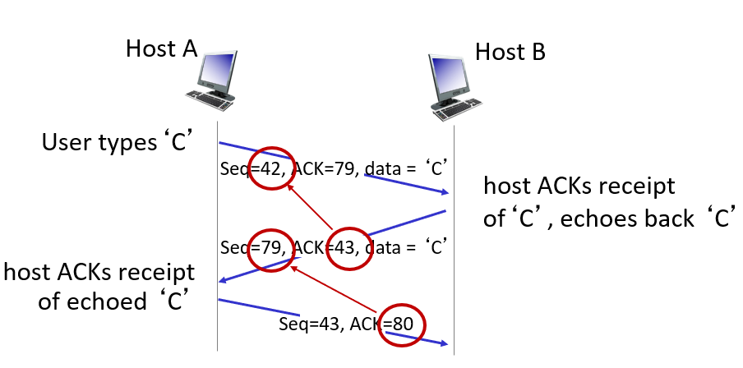
TCP sequence numbers, ACKs -- Explanation
Step-by-step explanation of what's happening in the diagram:
A user at Host A types the character 'c', which initiates a TCP segment to be sent to Host B.
The TCP segment from Host A to Host B has the following characteristics:
Sequence Number (Seq=42): This is the sequence number of the first byte in this segment. It's used to order segments on the receiving end.
Acknowledgment Number (ACK=79): This tells Host B that Host A has received all bytes up to byte 78 from Host B and is expecting byte 79 next.
Data = 'c': The actual data being sent, which in this case is the character 'c'.
Host B receives the TCP segment and processes it. To acknowledge receipt, Host B sends a TCP segment back to Host A:
Sequence Number (Seq=79): This is now Host B's sequence number, indicating the next byte number it expects to send.
Acknowledgment Number (ACK=43): Host B is acknowledging that it has received up to byte 42 from Host A and is expecting byte 43 next.
Data = 'c': Host B is echoing back the character 'c', as is typical in a telnet session.
Host A then acknowledges the receipt of the echoed 'c' from Host B:
Sequence Number (Seq=43): Host A is now sending a segment with the next sequence number.
Acknowledgment Number (ACK=80): Host A acknowledges all bytes received up to byte 79
and is expecting byte 80 next from Host B.
There is no data associated with this particular segment, as it's just an acknowledgment.

Slide 44
TCP round trip time, timeout
Q: how to set TCP timeout value?
longer than RTT, but RTT varies!
too short: premature timeout, unnecessary retransmissions
too long: slow reaction to segment loss
Q: how to estimate RTT?
SampleRTT:measured time from segment transmission until ACK receipt
ignore retransmissions
SampleRTT will vary, want estimated RTT “smoother”
average several recent measurements, not just current SampleRTT

Slide 45
TCP round trip time, timeout
EstimatedRTT = (1- α)*EstimatedRTT + α*SampleRTT
exponential weighted moving average (EWMA)
influence of past sample decreases exponentially fast
typical value: α = 0.125
RTT: gaia.cs.umass.edu to fantasia.eurecom.fr
RTT (milliseconds)
sampleRTT
EstimatedRTT
time (seconds)
Notes:
This is how TCP re-computes the estimated RTT each time a new SampleRTT is taken.
The process is knows as an exponentially weighted moving average, shown by the equation here.
<say it>
Where alpha reflects the influence of the most recent measurements on the estimated RTT; a typical value of alpha used in implementations is .125
The graph at the bottom show measured RTTs between a host in the Massachusetts and a host in France, as well as the estimated, “smoothed” RTT

Slide 46
TCP round trip time, timeout
timeout interval: EstimatedRTT plus “safety margin”
large variation in EstimatedRTT: want a larger safety margin
TimeoutInterval = EstimatedRTT + 4*DevRTT
estimated RTT
“safety margin”
DevRTT: EWMA of SampleRTT deviation from EstimatedRTT:
DevRTT = (1-β)*DevRTT + β*|SampleRTT-EstimatedRTT|
(typically, β = 0.25)
* Check out the online interactive exercises for more examples: http://gaia.cs.umass.edu/kurose_ross/interactive/
Notes:
Given this value of the estimated RTT, TCP computes the timeout interval to be the estimated RTT plus a “safety margin”
And the intuition is that if we are seeing a large variation in SAMPLERTT – the RTT estimates are fluctuating a lot - then we’ll want a larger safety margin
So TCP computes the Timeout interval to be the Estimated RTT plus 4 times a measure of deviation in the RTT.
The deviation in the RTT is computed as the eWMA of the difference between the most recently measured SampleRTT from the Estimated RTT

Slide 47
TCP Sender (simplified)
event: data received from application
create segment with seq #
seq # is byte-stream number of first data byte in segment
start timer if not already running
think of timer as for oldest unACKed segment
expiration interval: TimeOutInterval
event: timeout
retransmit segment that caused timeout
restart timer
event: ACK received
if ACK acknowledges previously unACKed segments
update what is known to be ACKed
start timer if there are still unACKed segments
Notes:
Given these details of TCP sequence numbers, acks, and timers, we can now describe the big picture view of how the TCP sender and receiver operate
You can check out FSMs in book; let’s just give an English text description here and let’s start with the sender.

Slide 48
TCP Receiver: ACK generation [RFC 5681]
Event at receiver
arrival of in-order segment with
expected seq #. All data up to
expected seq # already ACKed
arrival of in-order segment with
expected seq #. One other
segment has ACK pending
arrival of out-of-order segment
higher-than-expect seq. # .
Gap detected
arrival of segment that
partially or completely fills gap
TCP receiver action
delayed ACK. Wait up to 500ms
for next segment. If no next segment,
send ACK
immediately send single cumulative
ACK, ACKing both in-order segments
immediately send duplicate ACK,
indicating seq. # of next expected byte
immediate send ACK, provided that
segment starts at lower end of gap
Notes:
Rather than immediately Acknowledging this segment, many TCP implementations will wait for half a second for another in-order segment to arrive, and then generate a single cumulative ACK for both segments – thus decreasing the amount of ACK traffic. The arrival of this second in-order segment and the cumulative ACK generation that covers both segments is the second row in this table.

Slide 49
TCP: retransmission scenarios
Host A
Host B
Host A
Host B
SendBase=92
Seq=92, 8 bytes of data
Seq=92, 8 bytes of data
timeout
timeout
Seq=100, 20 bytes of data
ACK=100
X
ACK=100
ACK=120
Seq=92, 8 bytes of data
Seq=92, 8
bytes of data
SendBase=100
send cumulative
ACK for 120
SendBase=120
ACK=100
ACK=120
SendBase=120
lost ACK scenario
premature timeout
Notes:
To cement our understanding of TCP reliability, let’s look a a few retransmission scenarios
In the first case a TCP segments is transmitted and the ACK is lost, and the TCP timeout mechanism results in another copy of being transmitted and then re-ACKed a the sender
In the second example two segments are sent and acknowledged, but there is a premature timeout e for the first segment, which is retransmitted. Note that when this retransmitted segment is received, the receiver has already received the first two segments, and so resends a cumulative ACK for both segments received so far, rather than an ACK for just this fist segment.

Slide 50
TCP: retransmission scenarios
Host A
Host B
Lost ACK Scenario:
Host A sends 8 bytes of data starting at sequence number 92 to Host B.
Host B receives the data and sends an acknowledgment (ACK) for sequence number 100 back to Host A. This ACK tells Host A that Host B has received up to byte 99 and is expecting byte 100 next.
However, the acknowledgment (ACK for 100) is lost in the network, and Host A never receives it.
Host A waits for a while for the acknowledgment, but since it doesn't arrive, Host A assumes there was a problem with the data transfer.
After the timeout (the waiting period), Host A retransmits the same 8 bytes of data starting at sequence number 92, assuming the first attempt failed.
This time, Host B receives the data again and successfully sends the acknowledgment (ACK for 100), which Host A receives.
Now both hosts are in sync, and data transfer can continue.
Seq=92, 8 bytes of data
timeout
ACK=100
X
Seq=92, 8 bytes of data
ACK=100
lost ACK scenario
Notes:
To cement our understanding of TCP reliability, let’s look a a few retransmission scenarios
In the first case a TCP segments is transmitted and the ACK is lost, and the TCP timeout mechanism results in another copy of being transmitted and then re-ACKed a the sender
In the second example two segments are sent and acknowledged, but there is a premature timeout e for the first segment, which is retransmitted. Note that when this retransmitted segment is received, the receiver has already received the first two segments, and so resends a cumulative ACK for both segments received so far, rather than an ACK for just this fist segment.

Slide 51
TCP: retransmission scenarios
Premature Timeout Scenario:
Host A sends 8 bytes of data starting at sequence number 92 to Host B.
Host A then sends another 20 bytes of data starting at sequence number 100.
Host B receives the first 8 bytes and sends an ACK for 100, but there is a delay in the network.
Host B receives the second batch of data (20 bytes) and sends an ACK for 120, acknowledging all the data up to byte 119.
Host A experiences a premature timeout
Due to the premature timeout, Host A retransmits the first 8 bytes starting at sequence number 92, thinking it was lost.
Finally, Host A receives the ACK for 120 from Host B. This ACK is cumulative, meaning it acknowledges all data received up to byte 119. Host A understands that all data has been successfully received by Host B, including the retransmitted data.
Host A
Host B
SendBase=92
Seq=92, 8 bytes of data
timeout
Seq=100, 20 bytes of data
ACK=100
ACK=120
Seq=92, 8
bytes of data
SendBase=100
send cumulative
ACK for 120
SendBase=120
ACK=120
SendBase=120
premature timeout
Notes:
To cement our understanding of TCP reliability, let’s look a a few retransmission scenarios
In the first case a TCP segments is transmitted and the ACK is lost, and the TCP timeout mechanism results in another copy of being transmitted and then re-ACKed a the sender
In the second example two segments are sent and acknowledged, but there is a premature timeout e for the first segment, which is retransmitted. Note that when this retransmitted segment is received, the receiver has already received the first two segments, and so resends a cumulative ACK for both segments received so far, rather than an ACK for just this fist segment.

Slide 52
TCP: retransmission scenarios
Host A
Host B
Host A sends a packet of 8 bytes of data labeled with sequence number 92.
Next, it sends 20 bytes of data labeled with sequence number 100.
Host B receives the first packet (Seq=92), processes it, and sends back an acknowledgment (ACK=100) to Host A, which essentially says, "I've received everything up to sequence number 100, send the next packet."
However, the acknowledgment for the second packet (Seq=100) gets lost in the network.
Host A doesn’t receive the acknowledgment for Seq=100, but it sends another packet of 15 bytes of data labeled with sequence number 120.
Host B receives the third packet (Seq=120), and since TCP acknowledgments are cumulative, it sends an ACK=120 back to Host A, indicating that it has received all packets up to sequence number 120.
Seq=92, 8 bytes of data
Seq=100, 20 bytes of data
ACK=100
X
ACK=120
Seq=120, 15 bytes of data
cumulative ACK covers for earlier lost ACK
Notes:
And in this last example, two segments are again transmitted, the first ACK is lost but the second ACK, a cumulative ACK arrives at the sender, which then can transmit a third segment, knowing that the first two have arrived, even though the ACK for the first segment was lost

Slide 53

TCP fast retransmit
Host A
Host B
TCP fast retransmit
if sender receives 3 additional ACKs for same data (“triple duplicate ACKs”), resend unACKed segment with smallest seq #
likely that unACKed segment lost, so don’t wait for timeout
Seq=92, 8 bytes of data
Seq=100, 20 bytes of data
X
ACK=100
timeout
ACK=100
ACK=100
Receipt of three duplicate ACKs indicates 3 segments received after a missing segment – lost segment is likely. So retransmit!
ACK=100
Seq=100, 20 bytes of data
Notes:
Let’s wrap up our study of TCP reliability by discussing an optimization to the original TCP known as TCP fast retransmit,
Take a look at this example on the right where 5 segments are transmitted and the second segment is lost. In this case the TCP receiver sends an ACK 100 acknowledging the first received segment.
When the third segment arrives at the receiver, the TCP receiver sends another ACK 100 since the second segment has not arrived. And similarly for the 4th and 5th segments to arrive.
Now what does the sender see? The sender receives the first ACK 100 it has been hoping for, but then three additional duplicate ACK100s arrive. The sender knows that somethings’ wrong – it knows the first segment arrived at the receiver but three later arriving segments at the receiver – the ones that generated the three duplicate ACKs – we received correctly but were not in order. That is, that there was a missing segment at the receiver when each of the three duplicate ACK were generated.
With fast retransmit, the arrival of three duplicate ACK causes the sender to retransmit its oldest unACKed segment, without waiting for a timeout event. This allows TCP to recover more quickly from what is very likely a loss event
specifically that the second segment has been lost, since three higher -numbered segments were received

Slide 54
Chapter 3: roadmap
Transport-layer services
Multiplexing and demultiplexing
Connectionless transport: UDP
Principles of reliable data transfer
Connection-oriented transport: TCP
segment structure
reliable data transfer
flow control
connection management
Principles of congestion control
TCP congestion control

Slide 55
TCP flow control
application
process
Q: What happens if network layer delivers data faster than application layer removes data from socket buffers?
Application removing data from TCP socket buffers
TCP socket
receiver buffers
TCP
code
Network layer delivering IP datagram payload into TCP socket buffers
IP
code
from sender
receiver protocol stack
Notes:
(Presuming an intro)
Before diving into the details of TCP flow control, let’s first get the general context and motivate the need for flow control.
This diagram show a typical transport-layer implementation
A segment is brought up the protocol stack to the transport layer, and the segment’s payload is removed from the segment and written INTO socket buffers.
How does data get taken OUT of socket buffers? By applications performing socket reads, as we learned in Chapter 2.
And so the question is “What happens if network layer delivers data faster than an application-layer process removes data from socket buffers?”
Let’s watch a video of what happens when things arrive way too fast to fast to be processed.
<video>. (I love that video). Another human analogy showing the need for flow control is the saying – to use some English slang - “no one can drink from a firehose”
Flow control is a mechanism to the calamity of a receiver being over-run by a sender that is sending too fast – it allows the RECEIVER to explicitly control the SENDER so sender won’t overflow receiver’s buffer by transmitting too much, too fast

Slide 56


TCP flow control
application
process
Q: What happens if network layer delivers data faster than application layer removes data from socket buffers?
Application removing data from TCP socket buffers
TCP socket
receiver buffers
TCP
code
Network layer delivering IP datagram payload into TCP socket buffers
IP
code
from sender
receiver protocol stack
Notes:
(Presuming an intro)
Before diving into the details of TCP flow control, let’s first get the general context and motivate the need for flow control.
This diagram show a typical transport-layer implementation
A segment is brought up the protocol stack to the transport layer, and the segment’s payload is removed from the segment and written INTO socket buffers.
How does data get taken OUT of socket buffers? By applications performing socket reads, as we learned in Chapter 2.
And so the question is “What happens if network layer delivers data faster than an application-layer process removes data from socket buffers?”
Let’s watch a video of what happens when things arrive way too fast to fast to be processed.
<video>. (I love that video). Another human analogy showing the need for flow control is the saying – to use some English slang - “no one can drink from a firehose”
Flow control is a mechanism to the calamity of a receiver being over-run by a sender that is sending too fast – it allows the RECEIVER to explicitly control the SENDER so sender won’t overflow receiver’s buffer by transmitting too much, too fast

Slide 57
TCP flow control
application
process
Q: What happens if network layer delivers data faster than application layer removes data from socket buffers?
Application removing data from TCP socket buffers
TCP socket
receiver buffers
TCP
code
receive window
flow control: # bytes receiver willing to accept
IP
code
from sender
receiver protocol stack
Notes:
(Presuming an intro)
Before diving into the details of TCP flow control, let’s first get the general context and motivate the need for flow control.
This diagram show a typical transport-layer implementation
A segment is brought up the protocol stack to the transport layer, and the segment’s payload is removed from the segment and written INTO socket buffers.
How does data get taken OUT of socket buffers? By applications performing socket reads, as we learned in Chapter 2.
And so the question is “What happens if network layer delivers data faster than an application-layer process removes data from socket buffers?”
Let’s watch a video of what happens when things arrive way too fast to fast to be processed.
<video>. (I love that video). Another human analogy showing the need for flow control is the saying – to use some English slang - “no one can drink from a firehose”
Flow control is a mechanism to the calamity of a receiver being over-run by a sender that is sending too fast – it allows the RECEIVER to explicitly control the SENDER so sender won’t overflow receiver’s buffer by transmitting too much, too fast

Slide 58
TCP flow control
application
process
Q: What happens if network layer delivers data faster than application layer removes data from socket buffers?
Application removing data from TCP socket buffers
TCP socket
receiver buffers
TCP
code
flow control
receiver controls sender, so sender won’t overflow receiver’s buffer by transmitting too much, too fast
IP
code
from sender
receiver protocol stack
Notes:
(Presuming an intro)
Before diving into the details of TCP flow control, let’s first get the general context and motivate the need for flow control.
This diagram show a typical transport-layer implementation
A segment is brought up the protocol stack to the transport layer, and the segment’s payload is removed from the segment and written INTO socket buffers.
How does data get taken OUT of socket buffers? By applications performing socket reads, as we learned in Chapter 2.
And so the question is “What happens if network layer delivers data faster than an application-layer process removes data from socket buffers?”
Let’s watch a video of what happens when things arrive way too fast to fast to be processed.
<video>. (I love that video). Another human analogy showing the need for flow control is the saying – to use some English slang - “no one can drink from a firehose”
Flow control is a mechanism to the calamity of a receiver being over-run by a sender that is sending too fast – it allows the RECEIVER to explicitly control the SENDER so sender won’t overflow receiver’s buffer by transmitting too much, too fast

Slide 59
TCP flow control
TCP receiver “advertises” free buffer space in rwnd field in TCP header
RcvBuffer size set via socket options (typical default is 4096 bytes)
many operating systems auto-adjust RcvBuffer
sender limits amount of unACKed (“in-flight”) data to received rwnd
guarantees receive buffer will not overflow
to application process
RcvBuffer
buffered data
rwnd
free buffer space
TCP segment payloads
TCP receiver-side buffering
Notes:
Here’s how TCP implement flow control. The basic idea is simple – the receiver informs the sender how much free buffer space there is, and the sender is limited to send no more than this amount of data. That the value o RWND in the diagram to the right.
This information is carried from the receiver to the sender in the “receiver advertised window” (do a PIP of header) in the TCP header, and the value will change as the amount of free buffer space fluctuates over time.

Slide 60
TCP flow control
flow control: # bytes receiver willing to accept
TCP receiver “advertises” free buffer space in rwnd field in TCP header
RcvBuffer size set via socket options (typical default is 4096 bytes)
many operating systems auto-adjust RcvBuffer
sender limits amount of unACKed (“in-flight”) data to received rwnd
guarantees receive buffer will not overflow
receive window
TCP segment format
Notes:
Here’s how TCP implement flow control. The basic idea is simple – the receiver informs the sender how much free buffer space there is, and the sender is limited to send no more than this amount of data. That the value o RWND in the diagram to the right.
This information is carried from the receiver to the sender in the “receiver advertised window” (do a PIP of header) in the TCP header, and the value will change as the amount of free buffer space fluctuates over time.

Slide 61
TCP connection management
before exchanging data, sender/receiver “handshake”:
agree to establish connection (each knowing the other willing to establish connection)
agree on connection parameters (e.g., starting seq #s)
application
application
connection state: ESTAB
connection variables:
seq # client-to-server
server-to-client
rcvBuffer size
at server,client
connection state: ESTAB
connection Variables:
seq # client-to-server
server-to-client
rcvBuffer size
at server,client
network
network
Socket clientSocket =
newSocket("hostname","port number");
Socket connectionSocket = welcomeSocket.accept();
Notes:
The other TCP topic we’ll want to consider here is that of “connection management”
The TCP sender and receiver have a number of pieces of shared state that they must establish before actually communicating
FIRST they must both agree that they WANT to communicate with each other
Secondly there are connection parameters – the initial sequence number and the initial receiver-advertised bufferspace that they’ll want to agree on
This is done via a so-called handshake protocol – the client reaching our to the server, and the server answering back.
And before diving into the TCP handshake protocol, let’s first consider the problem of handshaking, of establishing shared state.

Slide 62


Agreeing to establish a connection
2-way handshake:
Q: will 2-way handshake always work in network?
variable delays
retransmitted messages (e.g. req_conn(x)) due to message loss
message reordering
can’t “see” other side
Let’s talk
ESTAB
OK
ESTAB
choose x
req_conn(x)
ESTAB
acc_conn(x)
ESTAB
Notes:
Here’s an example of a two way handshake. Alice reaches out to Bob and say’s “let’s talk” and Bob says OK, and they start their conversation
For a network protocol, the equivalent protocol would be a client sending a “request connection” message saying ”let’s talk, the initial sequence number is x”
And the server would respond with a message ”I accept your connect x”
And the question we want to ask ourselves is <talk through>
Will this work? Let’s look at a few scenarios…

Slide 63

2-way handshake scenarios
choose x
req_conn(x)
ESTAB
acc_conn(x)
ESTAB
data(x+1)
accept
data(x+1)
ACK(x+1)
connection
x completes
No problem!

Slide 64

2-way handshake scenarios
choose x
req_conn(x)
ESTAB
retransmit
req_conn(x)
acc_conn(x)
ESTAB
req_conn(x)
connection
x completes
client terminates
server
forgets x
ESTAB
acc_conn(x)
Problem: half open connection! (no client)

Slide 65
2-way handshake scenarios
choose x
req_conn(x)
ESTAB
retransmit
req_conn(x)
acc_conn(x)
ESTAB
data(x+1)
accept
data(x+1)
retransmit
data(x+1)
connection
x completes
client terminates
server
forgets x
req_conn(x)
ESTAB
data(x+1)
accept
data(x+1)
Problem: dup data
accepted!

Slide 66
TCP 3-way handshake
Server state
Client state
serverSocket = socket(AF_INET,SOCK_STREAM)
serverSocket.bind((‘’,serverPort))
serverSocket.listen(1)
connectionSocket, addr = serverSocket.accept()
clientSocket = socket(AF_INET, SOCK_STREAM)
LISTEN
clientSocket.connect((serverName,serverPort))
LISTEN
choose init seq num, x
send TCP SYN msg
SYNSENT
SYNbit=1, Seq=x
choose init seq num, y
send TCP SYNACK
msg, acking SYN
SYN RCVD
SYNbit=1, Seq=y
ACKbit=1; ACKnum=x+1
received SYNACK(x)
indicates server is live;
send ACK for SYNACK;
this segment may contain
client-to-server data
ESTAB
ACKbit=1, ACKnum=y+1
received ACK(y)
indicates client is live
ESTAB
Notes:
TCP’s three way handshake, that operates as follows
Let’s say the client and server both create a TCP socket as we learned about in Chapter 2 and enter the LISTEN state
The client then connects to the server sending a SYN message with a sequence number x (SYN Message is an TCP Segment with SYN but set in the header – you might want to go back and review the TCP segment format!)
The server is waiting for a connection, and receives the SYN message enters the SYN received state (NOT the established state and sends a SYN ACK message back.
Finally the client sends an ACK message to the server, and when the server receiver this enters the Established state. This is when the application process would see the return from the wait on the socket accept() call

Slide 67
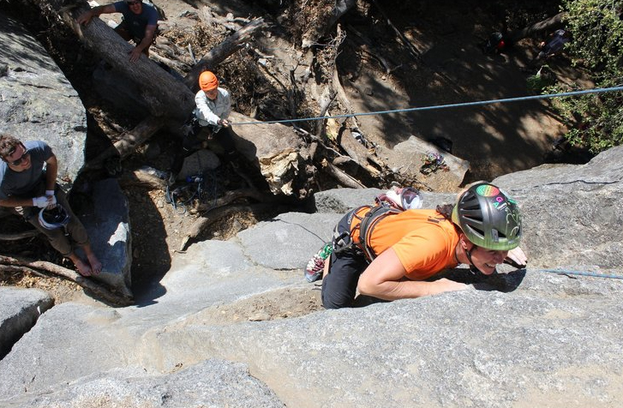
A human 3-way handshake protocol
1. On belay?
2. Belay on.
3. Climbing.
Notes:
As usual, there’s a human protocol analogy to the three way handshake, and I still remember thinking about this clinging for my life while climbing up a rockface
When you want start climbing you first say ON BELOW (meaning ARE YOU READY WITH MY SAFETY ROPE)
THE BELYER (server) responds BELAY ON (that lets you know the belayer is ready for you)
And then you say CLIMING
It’s amazing what can pass through your head when your clinging for your life o a

Slide 68
Closing a TCP connection
client, server each close their side of connection
send TCP segment with FIN bit = 1
respond to received FIN with ACK
on receiving FIN, ACK can be combined with own FIN
simultaneous FIN exchanges can be handled
Notes:
All good things must come to an end, and that’s true for a TCP connection as well.
And of course there’s a protocol for one side to gracefully close of a TCP connection using a FIN message, to which the other side sends a FINACK message and waits around a bit to respond to any retransmitted FIN messages before timing out.

